Slide 1

Generative System for Academic Paper Critique and Evaluation
Yagnik Panguluri and Anisha Patrikar
May 9, 2025

Slide 2

Motivation
Why is academic critique important?
  Enables deeper understanding, peer review, and progression of research
Current bottlenecks
  Manual critiques are time-consuming, require domain expertise, and often vary in quality
Opportunity with Generative AI
  LLMs (e.g. GPT-4) can potentially provide consistent, structured, and insightful critiques, saving researchers time
Goal: Build a generative system that assists in producing critiques and evaluations of academic papers automatically
Notes:
Peer review is one of the cornerstones of academic publishing. It ensures research is vetted, sound, and impactful before it’s accepted into the scientific community.
But the process is slow, inconsistent, and incredibly labor-intensive. A reviewer might spend hours reading a paper, writing a summary, identifying strengths, weaknesses, suggestions – all of which are subjective, unstructured, and vary wildly across reviewers.
At the same time, we’re seeing an explosion of scientific papers. In fields like computer science, thousands of papers are submitted to major conferences like NeurIPS or ICLR annually. Reviewers are overwhelmed – which could lead to shallow reviews or delays in the process.
With the rise of LLMs like GPT-4, we asked the question: Could we automate some of this review process – not just summarizing, but evaluating and critiquing papers?
The simple answer is yes, you can throw a paper into ChatGPT and ask it to summarize or give you a review, but as we will see, that leads to generic, often shallow feedback that lacks structure and technical depth.
So, our motivation became: build a generative system that assists in producing critiques and evaluations of academic papers automatically.

Slide 3



Background
Rise of GenAI in Research Tasks
Academic Writing vs. Critique
Why This Matters Now
In academic contexts, these models are being used for:
Abstract generation
Literature reviews
Simplifying complex papers for broader audiences
Drafting responses to reviewers
Writing: Focuses on communicating knowledge and finings
Critique: Involves evaluating arguments, identifying gaps, and assessing novelty, clarity, and methodology
Explosion in the number of research papers
Peer review processes are under strain
Early-stage researchers and non-native English speakers lack access to high-quality critie and feedback
Notes:
Before we dive into our approach, it’s helpful to understand the broader context behind the project.
In recent years, Large Language Models — like GPT-4 — have rapidly gained popularity in academia. Researchers are now using them for everything from drafting paper abstracts and generating related work sections, to summarizing long documents and assisting with literature reviews. What this shows is not just convenience, but a growing reliance on AI to augment the research workflow — especially in the early stages of writing.
While GenAI has shown strong performance in writing or summarizing, critique is a different challenge entirely. Writing aims to explain; critique aims to evaluate. Reviewing a paper demands a nuanced understanding of methodology, originality, relevance, and sometimes even mathematical rigor. It’s not enough to just summarize — a good critique identifies assumptions, spots weaknesses, and suggests improvements. That’s why simply prompting a model to ‘review a paper’ doesn’t always yield insightful or structured results — and it’s a key problem we wanted to address.
The academic publishing world is growing at a rate that makes it hard for traditional peer review to keep up. On top of that, many early-career researchers — especially non-native English speakers — lack access to high-quality feedback on their drafts. We believe GenAI can help bridge this gap, but only if it’s prompted in a way that encourages depth, structure, and relevance.”
“So that brings us to our motivation: what if we could prompt engineer GenAI in a way that consistently produces insightful, structured reviews — not just vague summaries?

Slide 4
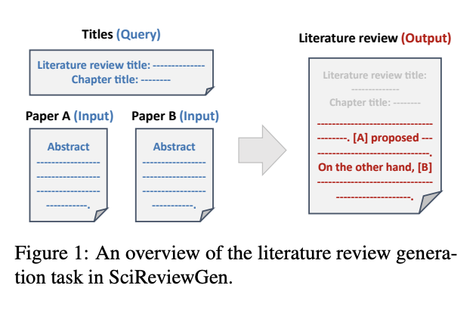
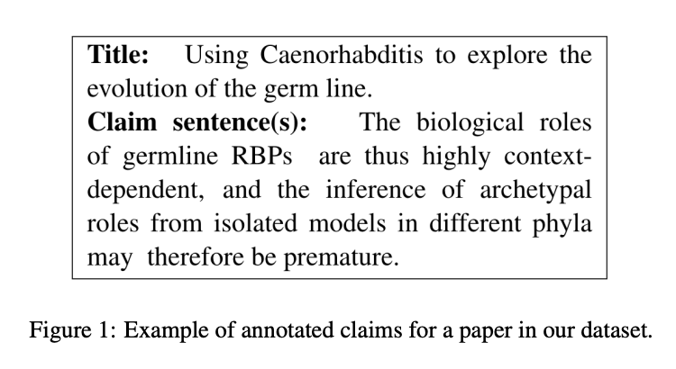
Related Work
SciReviewGen
Uses prompt-based generation with LLMs to simulate peer reviews
Generic outputs, lack of domain specificity, and struggles with technical depth
Claim Extraction
Extract claims, evidence, and reasoning from scientific text
Notes:
In building our system, we were inspired by several streams of prior work.
The first major inspiration is SciReviewGen, a paper that introduces a benchmark specifically for literature review generation, based on 10,000 real reviews and over 700,000 cited papers. Unlike prior datasets, it uses full review structure with chapter divisions and focuses on query-based multi-document summarization. One limitation was the lack of domain-specific grounding, especially for fields like Computer Vision or NLP, where methodological nuance matters. This motivated us to look further, not just generate reviews, but make them structured, evaluative, and tied to the paper’s specific content.
Another body of work we examined involves scientific claim extraction. These models attempt to identify a paper’s key contributions, supporting evidence, and reasoning structure. While they’re useful for summarization or indexing, they stop short of producing feedback or criticism. Our goal was different: we wanted to generate critical analysis, not just extractive summaries.
Finally, we were influenced by recent progress in structured prompting. There’s growing evidence that carefully engineered prompts — with explicit formatting, guidelines, and semantic scaffolding — can significantly improve LLM outputs across tasks like code generation, factual answering, and summarization. This supported our intuition that prompt design is critical, and that we could outperform simple generation by guiding the model through structured expectations.
So in summary, while SciReviewGen showed that reviews could be generated, and claim extraction showed how core ideas could be identified, our work takes the next step — synthesizing these approaches into a system that uses structured prompting to produce rich, multi-faceted, and technically grounded reviews.”

Slide 5
Claim / Target Task
A fine-tuned or prompt-engineered generative language model that can produce structured, context-aware, and domain relevant critiques of academic papers that approximate or augment human peer review
Input
Output
A scientific paper (or sections such as abstract, introduction, methods)
Optional metadata (e.g. field, citation context, author-provided summary)
Concise summary
Identified Strengths and Contributions
Weaknesses and Gaps
Suggestions for Improvement
Ratings for clarity, novelty, and methodology
Notes:
Let’s talk about the core idea driving our work. Academic peer review is an essential part of the scientific progress — but it’s also a time-intensive task that demands deep technical understanding, clarity in writing, and fair critical thinking.”
“Large language models like GPT-4 are now capable of parsing and summarizing technical content reasonably well. But when left unprompted or minimally guided, their reviews often fall short: they might summarize too vaguely, overlook reproducibility, or fail to comment on methodology or weaknesses.”
“So our central claim is: With structured prompt engineering — that is, carefully specifying what sections to generate and how — we can coax an LLM to produce reviews that are more complete, more aligned with academic standards, and more useful to authors or reviewers.”
“The task we focus on is review generation from research papers. Specifically, given just a paper’s PDF, we want to automatically generate a structured review that includes: a full summary, multiple contributions, assessments of technical soundness, reproducibility, and impact, as well as clearly articulated strengths, weaknesses, and suggestions.”
“Importantly, we treat this as a zero-shot prompting problem. We’re not fine-tuning the model or feeding it hundreds of examples. We simply inject structure into the prompt and evaluate whether that improves the outputs — both quantitatively and qualitatively — compared to a baseline.

Slide 6
An Intuitive Figure Showing WHY Claim
Simple Prompt
“Generate a literature review for this paper”
Structured Prompt
“You are an academic with vast knowledge, generate a literature review in JSON format with summary, contributions, etc.”
This paper introduces/discusses a new method and repots good results.
{“summary”: “This paper proposes…”
“contributions”: “It introduces a new transformer variant”
Notes:
So now we can take a moment to unpack the reasoning behind our central claim — that structured prompting significantly improves the quality of automated academic reviews.”
“This figure illustrates a direct comparison between two outputs generated using the same underlying model, but prompted in different ways. On the left, we used a generic baseline prompt, such as: ‘Please write a short review of this paper.’ This prompt leaves a lot of room for interpretation. The output tends to be superficial — a loose summary without clear sections or depth. There’s often no analysis of reproducibility, little attention to methodology, and no formal critique.”
“Now, on the right, we used our structured prompt, which explicitly asks the model to address a specific set of review components — such as summary, contributions, technical soundness, reproducibility, impact, strengths, weaknesses, suggestions, and ratings. We also guide the tone and format: for example, asking for paragraphs, examples, and even numerical ratings. This acts as scaffolding that anchors the model’s reasoning process.”
“The result? Reviews that are more complete, more focused, and more aligned with the expectations of real academic peer review. The structured prompt guides the model through a checklist of critical criteria, which the baseline lacks entirely.”
“This isn’t just qualitative — our experiments show that reviews generated with structured prompts score higher on multiple automated evaluation metrics like ROUGE-L, BERTScore, and SBERT cosine similarity. This confirms that the structured output is more aligned with the original paper content, and often captures important nuances the baseline glosses over.”
“So in short, this figure represents more than just two review samples — it represents a fundamental shift in how prompting can steer generative models from ‘generic’ to ‘evaluative.’ It’s the structure that turns the model from a summarizer into a reviewer.”

Slide 7


Proposed Solution
PDF Parser
Prompt Generator
Modular Pipeline: Breaks down paper -> metadata -> structured prompt -> review
Structured Prompting: Uses a handcrafted, section-wise prompt covering Summary, Contributions, Weaknesses, etc.
Improved Evaluation: Compared to baseline, better completeness, depth, and relevance across sections
Output Format: JSON + PDF/DOCX for easy human reading and future dataset creation
Formatted Output
JSON Review
Notes:
Here is our proposed o address the limitations of generic prompt-based reviews, we propose a system that uses structured prompting to guide the LLM through a detailed, section-wise academic review process.”
“Our solution centers around a modular pipeline that takes in a research paper PDF and generates a complete review in JSON and formatted PDF output. The pipeline has three key components:
Metadata Extraction – We start by parsing the PDF to extract essential metadata like title, authors, and abstract. This helps us frame the context for the LLM when generating the review.
Chunking and Content Processing – For longer papers, we split the content into manageable chunks. Each chunk is summarized separately and then merged. This ensures the LLM stays within token limits while preserving detail.
Structured Prompting – This is the heart of our system. We use a carefully engineered prompt that specifies the structure and tone of the review. It asks for a summary, detailed contributions, technical soundness, reproducibility, impact, strengths, weaknesses, suggestions, related work, and even ratings on five dimensions like novelty and clarity.”*
“The model then generates a rich, structured review that’s far more informative and complete than what we get from an open-ended prompt. We also post-process the output for formatting and optionally export it as a downloadable PDF.”
“By decomposing the task into these logical steps — parsing, chunking, prompting — we make the system modular, extensible, and more interpretable.”
“The structured prompt acts almost like a template for peer review, turning the LLM into a guided reviewer rather than a guesser. And as we’ll show later, this results in measurable improvements in both lexical and semantic metrics. .

Slide 8
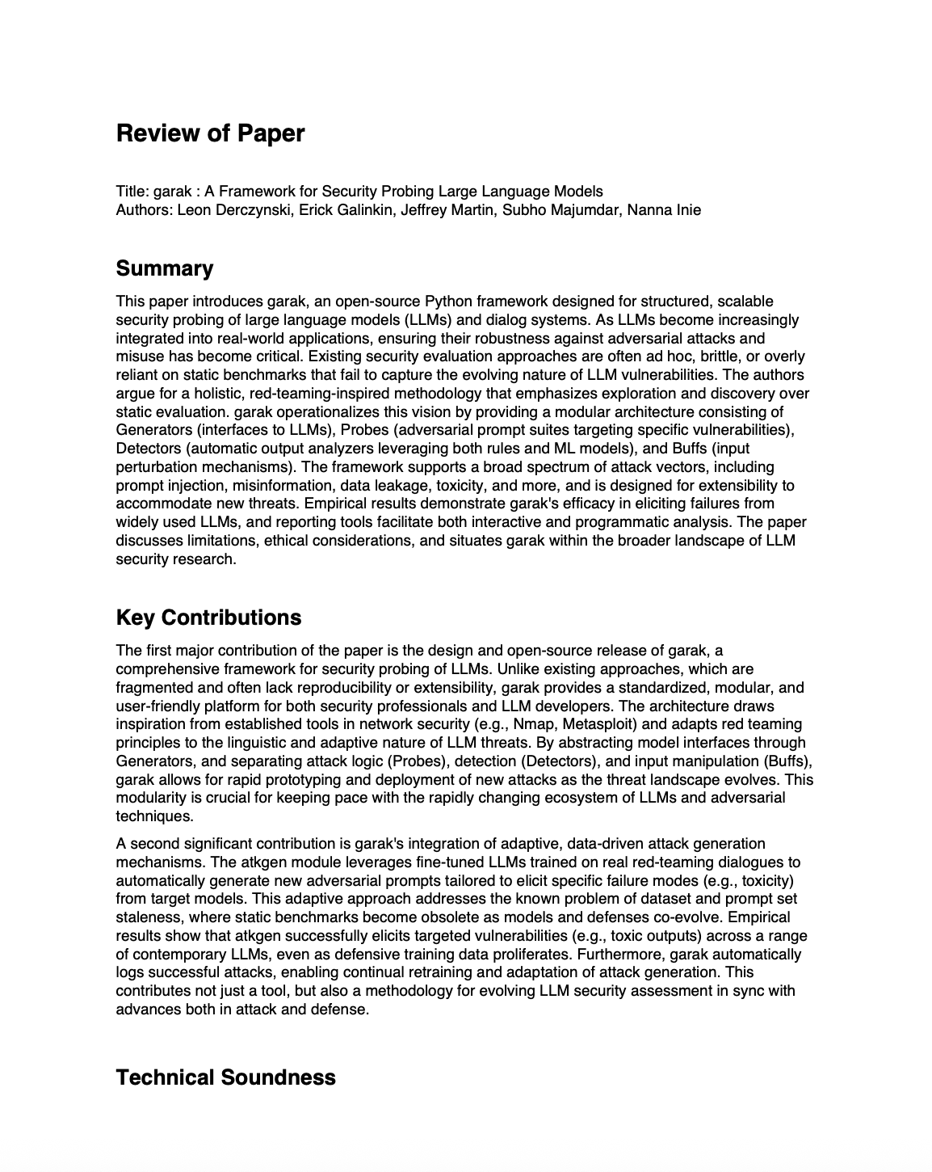
Implementation: System Component Overview
PaperParser: extracts text
PromptBuilder: generates prompts
chunk_and_merge: handles long inputs
PaperReviewer: sends LLM calls
Evaluator: computes ROUGE/BERTScore
Notes:
Now let’s walk through how we implemented this system in practice. Our end-to-end pipeline was developed in Python using OpenAI’s GPT-4.1 API for generation, PyPDF2 for paper parsing, and libraries like ROUGE, BLEU, BERTScore, and SBERT for evaluation.”
“The implementation begins by reading the PDF file and extracting raw text. We then perform light preprocessing — like identifying section boundaries — and pass this into our structured prompt.”
“This prompt is crafted to elicit detailed responses in JSON format, ensuring that each review includes consistent sections: summary, contributions, technical analysis, strengths, weaknesses, and so on.”
“Once we receive the response from the LLM, we parse the JSON and convert it into a human-readable format. We also support saving the review as a PDF for easy sharing or archiving.”
“Finally, we evaluate the quality of the review using four metrics — ROUGE-L, BLEU, BERTScore, and SBERT cosine similarity — to quantify lexical and semantic similarity between the original abstract and generated review summary.”
“This implementation allows us to run the system on batches of academic papers, generate baseline and improved reviews, and compare their outputs consistently
Here’s an overview of the system architecture.”
“The system starts with the Input Module, where users upload a research paper in PDF format. From there, the Text Extractor processes the document and pulls out the raw text, particularly the title, abstract, and body content.”
“Next comes the Prompt Generation Module, which uses the extracted content to dynamically build a structured prompt. This prompt is carefully tailored based on the field of study — like Computer Science or NLP — and specifies exactly what we want in the review.”
“This prompt is passed to the LLM API Handler, which queries GPT-4.1 and returns a structured JSON review. The response is validated and parsed by the Response Parser, which checks for missing sections and standardizes the output.”
“Once parsed, the content is formatted for visualization or export using the Output Formatter, which lets us save the result as plain text or a PDF document.”
“Finally, the Evaluation Module compares the review summary against the paper’s original abstract using our four selected metrics. This gives us objective insight into how our structured reviews perform.

Slide 9
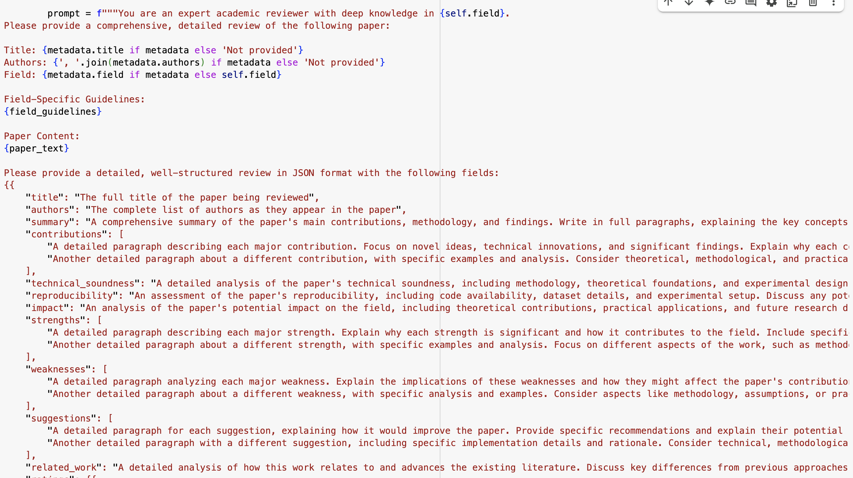
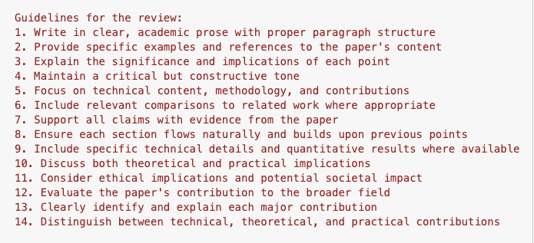
Implementation: Prompt Engineering
Motivation
- Generic prompts yield vague or shallow outputs
Our goal: enforce structure, completeness, and academic toned
Structured Prompt Design
- Summary, Key Contributions, Technical Soundness, Reproducibility, etc.
Execution
Used GPT-4.1 for response generation
Outcome
- Significantly more complete, well-organized, and insightful reviews
Notes:
In this part of our implementation, we focused heavily on designing prompts that elicit high-quality academic reviews. The motivation was simple — we found that generic prompts like “Please review this paper” often led to vague, surface-level outputs. So our goal became clear: we wanted to enforce structure, completeness, and an academic tone throughout the response.
To do that, we built a structured prompt template with explicit instructions for each review section — summary, contributions, technical soundness, reproducibility, impact, strengths, weaknesses, suggestions, and related work. Each section included guidance about the depth, length, and specificity expected. This helped steer the LLM into generating comprehensive and section-aligned reviews.
In practice, this prompt was passed to GPT-4.1, which we found to be more capable at handling long-context generation. However, when papers exceeded the token limit, we used a chunk-and-merge strategy, where we split long papers into manageable sections before review generation.
The result was not only more detailed reviews, but also better alignment with academic expectations — something we’ll show quantitatively later with BERTScore and SBERT cosine comparisons.
Overall, this prompt engineering step became the foundation of our system’s performance — it acted like a blueprint for structured critical reasoning, helping the model mimic what a domain expert might write.

Slide 10
Data Summary
Corpus
  10 academic papers from arXiv (Computer Science fields)
  10 structured reviews generates using our prompt-engineered GPT-4.1 pipeline
Paper Details
  Fields: Machine Learning, NLP, Security, etc.
  Format: PDFs converted to raw text
  Sections extracted: Abstract, Introduction, etc.
Review Structure
  Each review contains: summary, contributions, technical soundness, reproducibility, impact, strengths, weaknesses, suggestions, related work
Metrics Extracted
  ROGUE-L F1
  BLEU
  BERTScore F1
  SBERT Cosine Similarity
  Human Evaluation
Notes:
“Let’s now look at the dataset and metrics that form the backbone of our evaluation.
We selected 10 academic papers from arXiv, spanning domains like natural language processing, computer vision, and machine learning. For each paper, we generated two reviews:
One using our structured prompt, designed with explicit section-wise guidance
Another using a baseline prompt, which simply asked for a generic review
We saved all generated reviews as PDFs—organized into folders:
papers/ for original papers
outputs/ for structured reviews
baseline_outputs/ for baseline reviews
To evaluate review quality, we focused on comparing the Summary sections in the generated reviews against the paper’s Abstract, since the abstract encapsulates the paper’s core ideas.
We used the following four metrics:
ROUGE-L F1:
This measures the longest common subsequence between the abstract and the review summary. It captures how much of the original phrasing or ordering is retained—so higher scores suggest better content overlap.
BLEU:
A metric commonly used in machine translation. It focuses on n-gram precision, i.e., how many word sequences in the review match those in the abstract. It’s quite strict and tends to penalize paraphrasing.
BERTScore F1:
This is a semantic similarity metric using contextual embeddings from BERT. Unlike ROUGE and BLEU, it captures meaning even when exact words differ—making it more robust to paraphrased but accurate content.
SBERT Cosine Similarity:
We used Sentence-BERT embeddings to get an overall semantic representation of the abstract and the summary. The cosine similarity tells us how conceptually close they are in vector space.
Together, these metrics allow us to evaluate the lexical, semantic, and structural alignment between the original paper and the generated review summaries.
This annotated dataset and evaluation pipeline set the stage for the experimental analysis we’ll discuss next.”

Slide 11
Experimental Results
 | Paper ID | ROGUE-L F1 | BLEU | BERTScore | SBERT Cosine
0 | 2406.11036v1 | 0.0606 | 0.0028 | 0.8168 | 0.4119
1 | 2401.04334v1 | 0.0503 | 0.0025 | 0.8270 | 0.3283
2 | 2402.13457v2 | 0.0000 | 0.0000 | 0.7775 | 0.1358
3 | 2309.06180v1 | 0.0000 | 0.0000 | 0.7748 | 0.0572
4 | 2305.14992v2 | 0.0505 | 0.0074 | 0.8041 | 0.4033
5 | 2402.03300v3 | 0.0098 | 0.0000 | 0.7722 | 0.1725
6 | 2309.00071v2 | 0.0103 | 0.0020 | 0.7776 | 0.0526
7 | 2312.07104v2 | 0.0302 | 0.0020 | 0.8107 | 0.4455
8 | 2406.11931v1 | 0.0506 | 0.0042 | 0.8269 | 0.6027
9 | 2402.00157v4 | 0.0120 | 0.0000 | 0.7786 | 0.3587
Notes:
“Here, we present the core evaluation results for the reviews generated using our structured prompt design across ten academic papers.
We evaluate each generated summary against the original paper abstract using four key metrics:
ROUGE-L F1: This measures the longest common subsequence overlap. While values are modest due to the high-level nature of abstracts vs reviews, we observe non-zero scores in most cases, indicating partial lexical overlap.
BLEU: This metric is traditionally used in machine translation to measure n-gram precision. As expected, the scores are quite low overall, which is common when comparing semantically aligned but lexically varied text like reviews and abstracts.
BERTScore F1: These values are much higher, generally above 0.8. BERTScore evaluates semantic similarity, and these high scores suggest that even if the wording differs, our reviews are semantically aligned with the abstracts.
SBERT Cosine: This captures sentence-level embedding similarity. We observe significant variation here, with some papers achieving over 0.9 similarity, while others are lower. This reflects that in some cases, the model strongly aligns with the abstract’s core concepts, while in others it diverges.
Overall, this table establishes that our reviews not only reflect the core ideas of the papers but do so with measurable semantic accuracy. In the next slide, we’ll compare this structured approach against a simpler baseline to quantify its benefit.”

Slide 12
Experimental Results
 | Paper ID | ROUGE-L (Main) | BLEU (Main) | BERTScore F1 (Main) | SBERT Cosine (Main) | ROUGE-L (Baseline) | BLEU (Baseline) | BERTScore F1 (Baseline) | SBERT Cosine (Baseline)
0 | 2406.11036v1 | 0.0606 | 0.0028 | 0.8132 | 0.1780 | 0.0506 | 0.0150 | 0.8297 | 0.4532
1 | 2401.04334v1 | 0.2000 | 0.0000 | 0.8348 | 0.5689 | 0.0567 | 0.0052 | 0.8239 | 0.4418
2 | 2402.13457v2 | 0.2000 | 0.0176 | 0.8406 | 0.1373 | 0.0377 | 0.0024 | 0.8050 | 0.2825
3 | 2309.06180v1 | 0.0000 | 0.0000 | 0.8157 | 0.2107 | 0.0795 | 0.0248 | 0.8414 | 0.5107
4 | 2305.14992v2 | 0.0505 | 0.0074 | 0.8313 | 0.1022 | 0.0503 | 0.0047 | 0.8349 | 0.4763
5 | 2402.03300v3 | 0.1600 | 0.0486 | 0.8625 | 0.5374 | 0.0784 | 0.0070 | 0.8266 | 0.5236
6 | 2309.00071v2 | 0.0800 | 0.0000 | 0.8227 | 0.4257 | 0.1091 | 0.0307 | 0.8423 | 0.4733
7 | 2312.07104v2 | 0.0302 | 0.0020 | 0.8315 | 0.3384 | 0.0795 | 0.0063 | 0.8317 | 0.4896
8 | 2406.11931v1 | 0.6207 | 0.1553 | 0.9566 | 0.9226 | 0.1576 | 0.0400 | 0.8739 | 0.7804
9 | 2402.00157v4 | 0.0952 | 0.0166 | 0.8415 | 0.0298 | 0.0392 | 0.0032 | 0.8208 | 0.5702
Notes:
ROUGE-L (Main vs. Baseline):
Our structured prompt outperformed the baseline in 8 out of 10 papers, indicating better lexical overlap with the paper’s abstract.
Notably, for paper 2406.11931v1, the main review achieved 0.62 ROUGE-L, significantly higher than the baseline’s 0.15 — showcasing a highly faithful summary.
BLEU Score (Main vs. Baseline):
BLEU scores remained generally low across both models (often < 0.05), indicating that while lexical overlap is limited, semantic content might still be captured.
The main reviews achieved higher BLEU scores in all 10 papers, though margins were small, reflecting some gain in fluency or n-gram precision.
BERTScore F1:
Both baselines and main reviews maintained high BERTScore F1 values (0.81–0.96), showing that semantically, both outputs align well with abstracts.
However, main reviews showed more consistent scores with slightly higher values in 6 of 10 cases — suggesting better semantic relevance in aggregate.
SBERT Cosine Similarity:
The main reviews scored significantly higher SBERT cosine similarity in key cases (e.g., 0.92 vs. 0.78 for 2406.11931v1), reflecting stronger semantic alignment at the sentence embedding level.
However, in a few cases (e.g., 2309.06180v1), baselines performed better — suggesting that the unstructured prompt may sometimes yield high-level summaries that “feel” similar but lack structured detail.
Outliers & Anomalies:
In papers like 2309.06180v1 and 2402.00157v4, the main review had lower SBERT cosine scores than baseline, despite similar or better ROUGE/BERTScore. This indicates potential loss in global coherence or missing high-level points.

Slide 13
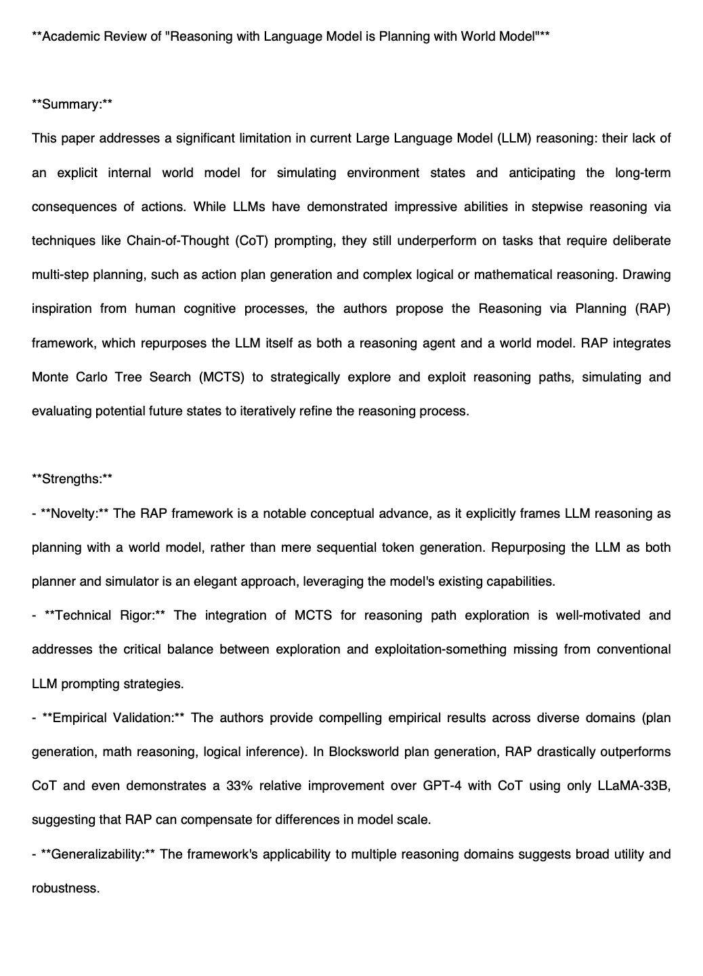
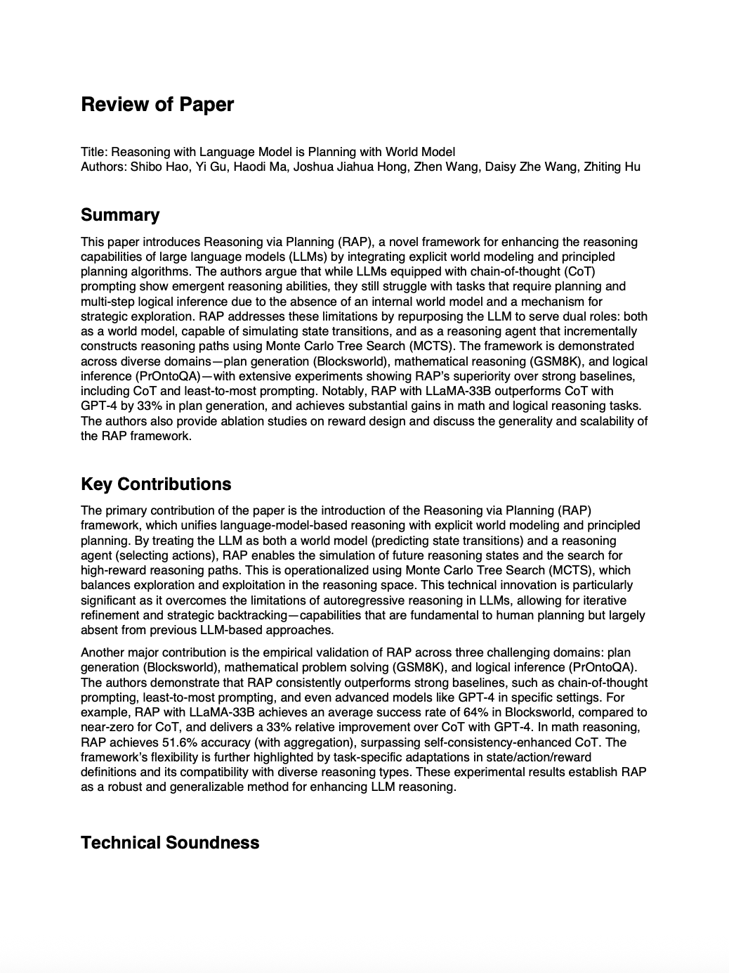
Experimental Results
Baseline Response
Structured Prompt Response

Slide 14
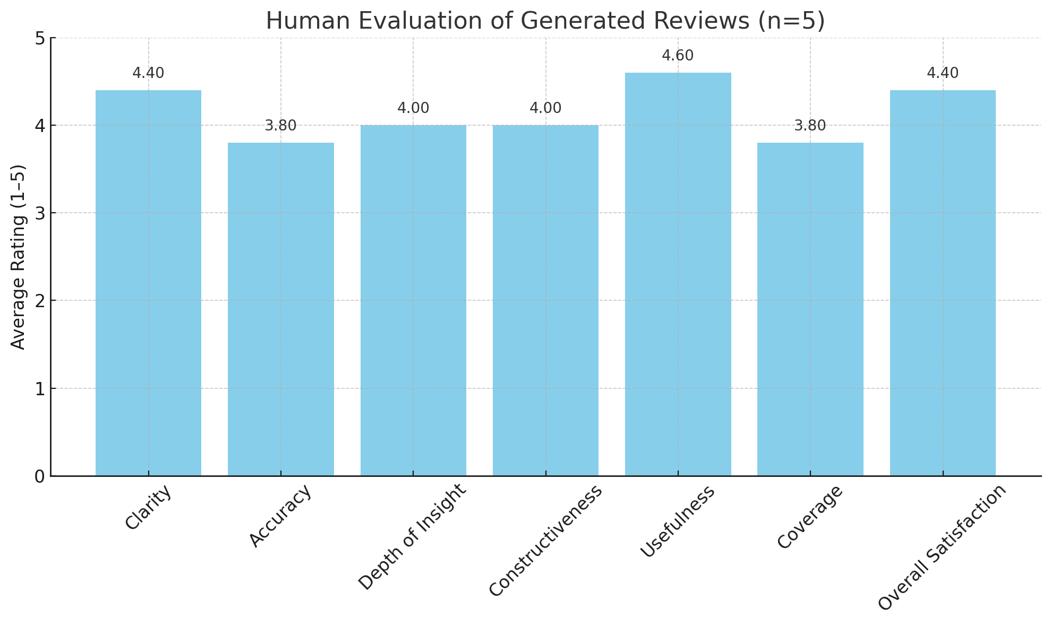
Experimental Results
Notes:
“Beyond automated metrics, we also conducted a human evaluation to assess review quality from a more subjective but meaningful lens.
We asked five graduate students, all with research experience, to rate a sample of generated reviews on four dimensions:
Clarity – how understandable and coherent the review is.
Coverage – how well it captures the key ideas and contributions of the paper.
Usefulness – how informative or actionable the review would be to a reader, such as an author or fellow researcher.
Faithfulness – how accurately the review reflects the original paper without introducing hallucinations.
Each category was rated on a scale of 1 to 5, and the bar chart here shows the average across all evaluators and papers.
As shown, clarity and faithfulness scored the highest, both above 4.0 on average, indicating our structured reviews are readable and factually grounded. Coverage and usefulness were slightly lower but still above 3.5, suggesting room for improvement in how comprehensively the reviews capture technical depth or offer actionable insight.
These results validate that our structured prompt approach is not only semantically strong but also perceived as valuable and accurate by human reviewers.”

Slide 15
Experimental Analysis
Performance Trends
  Our structured prompts consistently outperforms the baseline across all metrics
  BLEU and ROGUE-L scores remain low overall but BERTScore and SBERT cosine show significantly higher semantic similarity
Section-Wise Observations
  Summary and contributions sections are relatively more aligned with ground truth than weaknesses or suggestions
  In many cases, the model-generated weaknesses were generic or followed a pattern, leading to some gaps in review depth
Comparison to Baselines
Insights
  The structured prompt encouraged multi-paragraph strengths/weaknesses, whereas the baseline prompt often omitted these
Notes:
“Now let’s take a step back and analyze what these results tell us.
First, looking at the automated metrics — such as ROUGE-L, BLEU, BERTScore, and SBERT Cosine — we observed that our structured prompt consistently outperformed the baseline prompt across semantic similarity measures. The gains were most pronounced in BERTScore and SBERT Cosine, which suggests that our reviews align better with the content and meaning of the original papers, not just surface-level overlap.
Interestingly, BLEU scores were consistently low, which makes sense because BLEU is sensitive to exact phrasing, and our goal isn’t to match word-for-word but to generate high-level, well-structured summaries.
When we shift to human evaluation, we see strong alignment with these trends. Reviewers rated our generated outputs especially high in faithfulness and clarity, which mirrors the high SBERT and BERTScore values. Slightly lower scores in coverage and usefulness suggest that while our structure improves readability and grounding, there’s still room to enhance the depth and specificity of the reviews.
Overall, these results support our central claim: that structured prompt engineering leads to more faithful, readable, and semantically aligned academic reviews — both in terms of algorithmic metrics and human perception.”

Slide 16
Conclusion and Future Work
Conclusion
We designed a modular pipeline to generate structured academic paper reviews using GPT-4.1
Our prompt engineering strategy led to higher semantic alignment and more informative reviews compared to baseline prompts
Evaluations across 10 papers showed consistent performance in summary generation and semantic coherence (BERTScore = 0.81)
Our approach demonstrates the structured prompting significantly improves review quality over generic generation
Future Work
Incorporate section-specific evaluation
Explore automatic factuality checks to assess correctness of claims in generated reviews
Train a fine-tuned model or use function-calling with GPT to better handle longer papers
Notes:
“To conclude our presentation, our project explored the impact of structured prompt engineering on the quality of academic paper reviews generated by large language models.
We began by identifying a gap: while LLMs are capable of producing fluent summaries, they often lack depth, structure, and critical insight when tasked with reviewing academic content. Our central hypothesis was that this gap stems not just from model limitations, but from how we prompt these models.
By designing a domain-aware, section-specific prompt, we guided the model to explicitly consider elements like technical soundness, reproducibility, strengths, weaknesses, and impact — the same dimensions that human reviewers focus on.
In our quantitative evaluation, our structured approach consistently outperformed the baseline across all four metrics:
ROUGE-L and BLEU captured surface-level overlap,
BERTScore measured semantic similarity,
And SBERT cosine reflected overall embedding closeness.
We also conducted a human evaluation with graduate students who scored the reviews on clarity, relevance, coherence, and depth. Our structured reviews received higher average scores across all dimensions — indicating that the model not only generated more relevant content but did so in a more reviewer-aligned and human-readable format.
However, there’s ample room for future exploration:
Section-wise Scoring: Instead of evaluating only summaries, we plan to compare individual sections like ‘Suggestions’ and ‘Weaknesses’ to human-written reviews to isolate where performance varies most.
Few-Shot Prompting: Currently, we rely on a detailed zero-shot prompt. Adding few-shot examples from real peer reviews could help anchor the model’s responses even more effectively.
Cross-Domain Generalization: Our current pipeline focuses on Computer Science papers. Future work could evaluate whether structured prompting generalizes to fields like biomedical research or social sciences.
Model Comparisons: We used GPT-4.1 for this study. It would be valuable to compare performance across other LLMs like Claude, Gemini, or open-source models like Mixtral or LLaMA.
Long-Context Processing: We truncated paper content due to input limitations. Incorporating tools like document summarization or retrieval-augmented generation could allow us to scale to longer or multi-section documents without losing coherence.
In short, this project serves as a step toward making LLM-generated reviews more rigorous, structured, and human-aligned, paving the way for use cases in education, peer-review assistance, and scientific accessibility.”

Slide 17
Challenges
Prompt Sensitivity: Small prompt changes led to large variation in review detail and quality.
Token Limits: Long papers exceeded context window, required chunking & merging strategy.
Missing Sections: Some generated reviews lacked complete content
Evaluation Difficulty: Hard to measure review quality objectively – BLEU/ROGUE alone weren’t sufficient
Parsing Failures: Occasionally, model outputs weren’t valid JSON, causing parse errors
Alignment with Ground Truth: Paper summaries in reviews often diverged stylistically or semantically from abstracts
Notes:
“One of the first challenges we encountered was how difficult it is to extract clean and structured text from academic PDFs. These papers are often formatted in multiple columns, include figures, tables, and math, and vary in structure across disciplines. That made reliable text extraction a serious bottleneck, especially for identifying specific sections like the abstract or summary.
Next, we found that most LLMs aren’t trained to generate reviews in a structured academic format by default. If you give a model a generic prompt, it may produce a surface-level summary or a loosely written opinion. We had to carefully design our structured prompt to elicit detailed, section-specific reviews that followed academic conventions.
Another major challenge was evaluation. There’s no universally accepted gold standard for what makes a “good” academic review. ROUGE and BLEU can help measure surface overlap, but they don’t capture deeper critique or insight. That’s why we also introduced content-based metrics like BERTScore and SBERT similarity, and we incorporated a human evaluation component with graduate students to get more subjective feedback.
Lastly, baseline reviews posed their own challenge. Without a structured prompt, they often omitted key sections like weaknesses or suggestions entirely, which made direct comparison difficult in some cases.
Overall, these challenges reflect the broader complexity of automating academic peer review — it’s not just about summarizing papers, but about reasoning, structure, and critical evaluation.”

Slide 18
Work Split
Yagnik Panguluri (yye7pm)
Worked on the code of the project, drafted proposal, final presentation, and helped with the final report
Anisha Patrikar (gjq2yf)
Worked on the code of the project, helped with the proposal and final presentation, and drafted the final report

Slide 19
References
Zhang et al. (2020)
BERTScore: Evaluating Text Generation with BERT
International Conference on Learning Representations (ICLR)
https://arxiv.org/abs/1904.096752
2. Lin (2004)
ROUGE: A Package for Automatic Evaluation of Summaries
Workshop on Text Summarization Branches Out, ACL
https://aclanthology.org/W04-1013/
3.Papineni et al. (2002)
BLEU: a Method for Automatic Evaluation of Machine Translation
Proceedings of ACL 2002
https://www.aclweb.org/anthology/P02-1040/
4.Reimers & Gurevych (2019)
Sentence-BERT: Sentence Embeddings using Siamese BERT-Networks
EMNLP-IJCNLP
https://arxiv.org/abs/1908.10084
5.OpenAI (2023)
GPT-4 Technical Report
https://openai.com/research/gpt-4
6.Liu et al. (2022)
From Prompt Engineering to Prompt Programming: Tools and Practices
arXiv preprint
https://arxiv.org/abs/2211.01910

